Slide 1
Introduction to big Data Analytics
Prepared By:
Aayushi Chaudhari,
Assistant Professor, CE, CSPIT, CHARUSAT
Notes:
Communication in any form i.e. verbal or non-verbal is vital to
complete various daily routine tasks and plays a signicant role in
life. Facial expression is the most eective form of non-verbal
communication and it provides a clue about emotional state, mindset
and intention.
One of the important ways humans display emotions is through facial expressions. Facial expression recognition is one of the most powerful, natural and immediate means for human beings to communicate their emotions and intensions.

Slide 2
Agenda
What is Big data?
What is Big Data Analytics
Big Data Characteristics
Types of Big Data
Big data domains
Use cases of big data
Traditional vs Big Data Approach
Big data analytics technologies
Infrastructure for Big Data
Use of Data Analytics
Big Data Challenges

Slide 3
Introduction to Big Data

Slide 4
What is Big Data?
Massive amount of data which cannot be stored, processed and analyzed using traditional tools is known as big data.
Big data is lot of data in terabyte or petabyte.
It includes collection of large and complex data sets, that it becomes difficult to process using traditional data processing tools and applications.
Complex data does not mean just few tables or columns, it would contain various type of data in it, such as Structured, Unstructured, Semi- structured.
Eg: Facebook data (500+ TB/day)
Data coming with huge velocity.

Slide 5
What is Big Data?
Too much of data will be generated using smart devices within next 5 years.
Around 50 billion smart devices will be function in that era.
Even today 2.5 Quintillion bytes of data is generated everyday.
There are around 6.1 billions of smart phone users, that is 4 to 6 times larger than now.
As of now, several companies are using big data tools i.e. 35%.

Slide 6




What is big data analytics?
It is a process of extracting meaningful information from big data such as hidden patterns, unknown correlations, market trends and customer preferences.
It is useful for lowering the risk in banking systems.
It is used for product development and innovations.
It helps in quicker and better decision making in organizations.
Helps improve the customer experience.

Slide 7
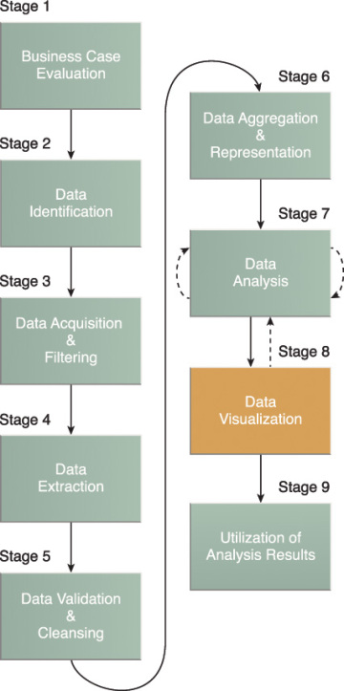
Lifecycle of big data analytics
Stage 1: Motive behind the analysis is finalized(How and what).
Stage 2: Identify the sources of gathering the data.
Stage 3: Remove the unwanted corrupt data using filtering process.
Stage 4: Make the data compatible for analytics tool by extracting
and transforming it to compatible form.
Stage 5: Used for data validation and cleaning.
Stage 6: Data with same fields will be integrated.
Stage 7: Analytical and statistical tools are used to get the meaningful
information from the data.
Stage 8: Results of stage 6 are visualized graphically.
Stage 9: Decision making by organizations.

Slide 8
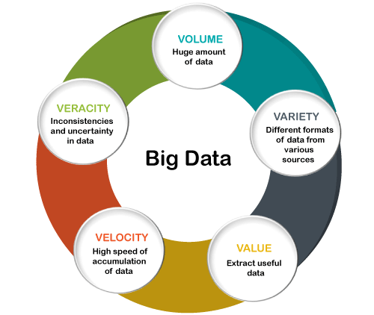
Big Data Characteristics
Volume: the size and amounts of big data that companies manage and analyze.
Value: the most important “V” from the perspective of the business, the value of big data usually comes from insight discovery and pattern recognition.
Variety: the diversity and range of different data types, including unstructured data, semi-structured data and raw data.
Velocity: the speed at which companies receive, store and manage data.
Veracity: the “truth” or accuracy of data and information assets, which often determines executive-level confidence.

Slide 9
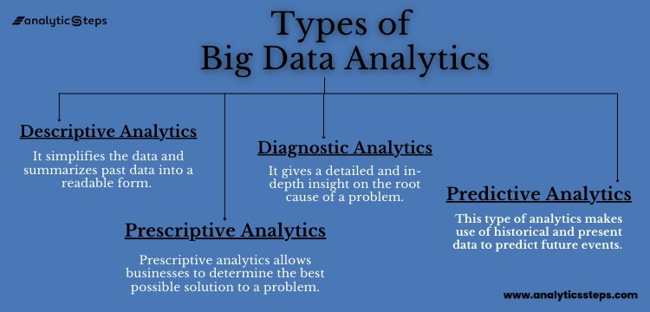
Types of big data analytics
There are four main types of big data analytics: diagnostic, descriptive, prescriptive, and predictive analytics.

Slide 10
Descriptive Analytics - What happened?
Descriptive Analytics is considered as a useful technique for uncovering patterns within a certain segment of customers.
It simplifies the data and summarizes past data into a readable form.
Descriptive analytics provide insights into what has occurred in the past and with the trends to dig into for more detail.
This helps in creating reports like a company’s revenue, profits, sales, and so on.
Examples of descriptive analytics include
Data Queries
Reports
Descriptive Statistics
Data dashboard

Slide 11
Diagnostics Analysis - Why did this happen?
Diagnostic Analytics, as the name suggests, gives a diagnosis to a problem.
It gives a detailed and in-depth insight into the root cause of a problem.
Data scientists turn to this analytics craving for the reason behind a particular happening.
Techniques like drill-down, data mining, and data recovery, churn reason analysis, and customer health score analysis are all examples of diagnostic analytics.

Slide 12
Predictive Analytics - What might happen in the future?
Predictive Analytics, as can be discerned from the name itself, is concerned with predicting future incidents. These future incidents can be market trends, consumer trends, and many such market-related events.
This type of analytics makes use of historical data and present data to predict future events. This is the most commonly used form of analytics among businesses.
Example: It uses all past payment data and user behavior data to predict fraudulent activities.
One predictive analytics tool is regression analysis, which can determine the relationship between two variables (single linear regression) or three or more variables (multiple regression).

Slide 13
Prescriptive Analytics - What should we do next?
Prescriptive analytics is the process of using data to determine an optimal course of action.
This type of analysis goes beyond explanations and predictions to recommend the best course of action moving forward.
prescriptive analytics is a valuable tool for data-driven decision-making.
Prescriptive analytics goes beyond predicting future outcomes by also suggesting action benefit from the predictions and showing the decision maker the implication of each decision option.
Prescriptive Analytics not only anticipates what will happen and when to happen but also why it will happen.
Prescriptive Analytics can suggest decision options on how to take advantage of a future opportunity or mitigate a future risk and illustrate the implication of each decision option.

Slide 14
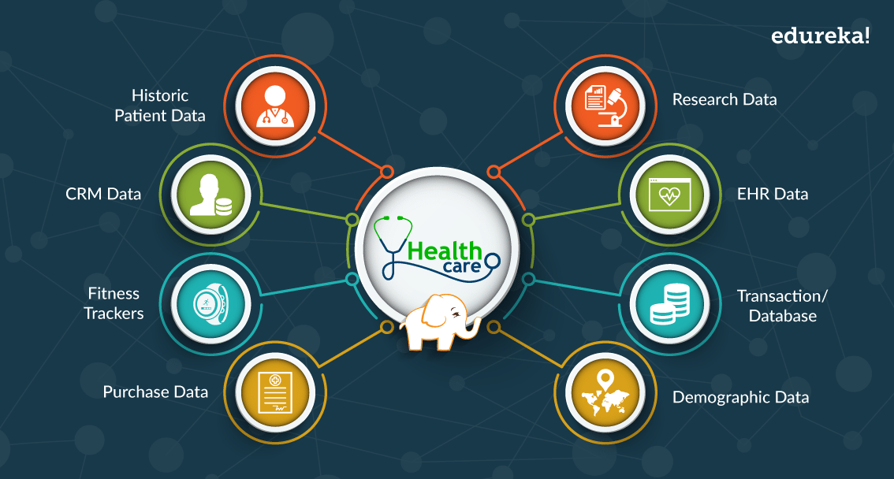
Big data domains - Healthcare

Slide 15
Manufacturing
Major benefits of using Big Data applications in manufacturing industry are:
Product quality and defects tracking
Supply planning
Manufacturing process defect tracking
Output forecasting
Increasing energy efficiency
Testing and simulation of new manufacturing processes
Support for mass-customization of manufacturing

Slide 16
Media & Entertainment
Big Data applications benefits media and entertainment industry by:
Predicting what the audience wants
Scheduling optimization
Increasing acquisition and retention
Ad targeting
Content monetization and new product development

Slide 17
Use Cases of Big data analytics
Log analytics
Big data log analytics applications are now widely used for various business goals, from IT system security and network performance, to market trends and e-commerce personalization.
E-commerce personalization
A powerful search and big data analytics platform allows e-commerce companies to (1) clean and enrich product data for a better search experience on both desktops and mobile devices; and (2) use predictive analytics and machine learning to predict user preferences through log data, then personalize products in a most-likely-to-buy order that maximizes conversion.

Slide 18
Use Cases of Big data analytics
Recommendation engines
Big data, with its scalability and power to process massive amounts of both structured (eg. video titles users search for, music genre they prefer) and unstructured data (eg. user viewing/listening patterns), can enable companies to analyze billions of clicks and viewing data from you and other users like you for the best recommendations.
Automated candidate placement in recruiting
A big data recruitment platform can mine from internal databases and provide a 360-degree view of a candidate, such as education, experience, skill sets, job titles, certifications, geography, and anything else recruiters can think of, then compare them to the company’s past hiring experience, salaries, previously successful candidates, etc. to identify the “best match.”

Slide 19

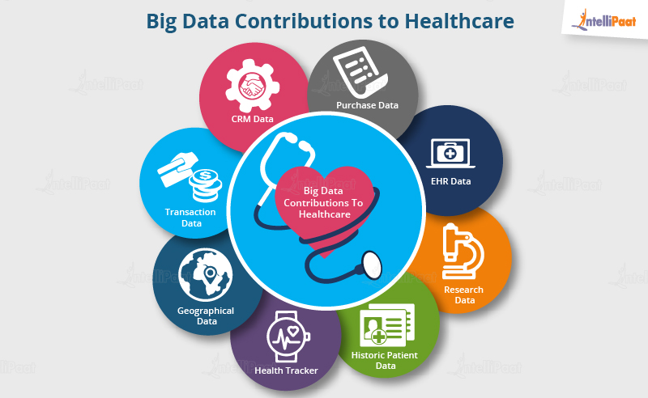
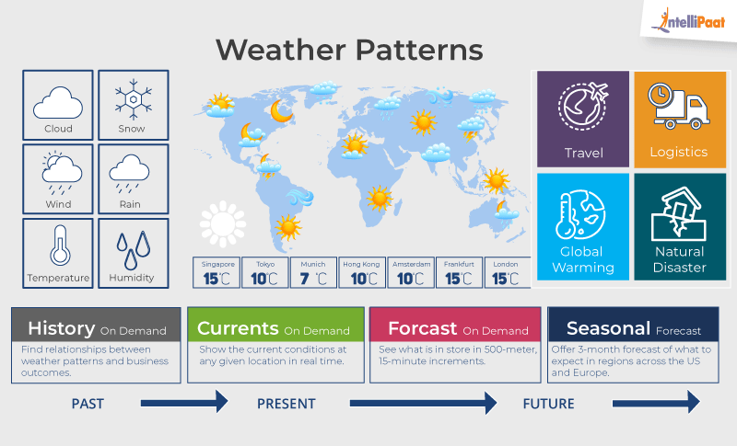
Use Cases of Big data analytics

Slide 20
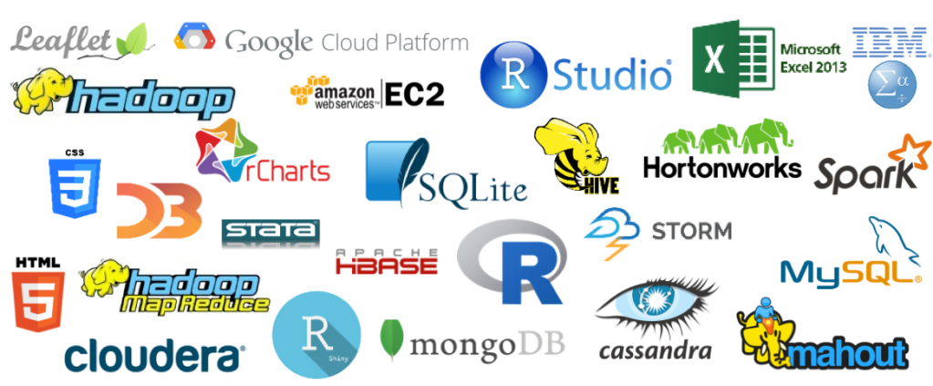
Big data Analytical Tools

Slide 21
Big Data Analytics Tools
Top 10 big data tools –
Apache Hadoop
Apache Spark
Flink
Apache Storm
Apache Cassandra
MongoDB
Kafka
Tableau
RapidMiner
R Programming

Slide 22
Apache Hadoop
Apache Hadoop is one of the most popularly used tools in the Big Data industry.
Hadoop is an open-source framework from Apache and runs on commodity hardware. It is used to store, process and analyze Big Data.
Hadoop is written in Java. Apache Hadoop enables parallel processing of data as it works on multiple machines simultaneously. It uses clustered architecture.
Hadoop does not support real-time processing. It only supports batch processing.
Hadoop cannot do in-memory calculations.
It consists of 3 parts-
Hadoop Distributed File System (HDFS) – It is the storage layer of Hadoop.
Map-Reduce – It is the data processing layer of Hadoop.
YARN – It is the resource management layer of Hadoop.

Slide 23
Apache Spark
Spark supports both real-time as well as batch processing. It is a general-purpose clustering system.
It also supports in-memory calculations, which makes it 100 times faster than Hadoop. This is made possible by reducing the number of read/write operations into the disk.
It provides more flexibility and versatility as it works with different data stores such as HDFS, OpenStack and Apache Cassandra.
It offers high-level APIs in Java, Python, Scala and R.
It also consists of 80 high-level operators for efficient query execution.

Slide 24
Apache Storm
Apache Storm is an open-source big data tool, distributed real-time and fault-tolerant processing system.
It efficiently processes unbounded streams of data.
By unbounded streams, we refer to the data that is ever-growing and has a beginning but no defined end.
Apache Storm is used with any of the programming languages and it further supports JSON based protocols.
The processing speed of Storm is very high.
It is easily scalable and also fault-tolerant.
It is much easier to use. It guarantees the processing of each data set.

Slide 25
Apache Cassandra
Apache Cassandra is a distributed database that provides high availability and scalability without compromising performance efficiency.
It is one of the best big data tools that can accommodate all types of data sets namely structured, semi-structured, and unstructured.
It is the perfect platform for mission-critical data with no single point of failure and provides fault tolerance on both commodity hardware and cloud infrastructure.
Cassandra works quite efficiently under heavy loads. Apache Cassandra supports the ACID (Atomicity, Consistency, Isolation, and Durability) properties.

Slide 26
MongoDB
MongoDB is an open-source data analytics tool, NoSQL database that provides cross-platform capabilities. It is exemplary for a business that needs fast-moving and real-time data for taking decisions.
MongoDB is perfect for those who want data-driven solutions. It is user-friendly as it offers easier installation and maintenance. MongoDB is reliable as well as cost-effective.
It is written in C, C++, and JavaScript. It is one of the most popular databases for Big Data as it facilitates the management of unstructured data or the data that changes frequently.
MongoDB uses dynamic schemas. Hence, you can prepare data quickly. This allows in reducing the overall cost. It executes on MEAN software stack, NET applications and, Java platform. It is also flexible in cloud infrastructure.

Slide 27
Apache Flink
Apache Flink is an Open-source distributed processing framework data analytics tool for bounded and unbounded data streams.
It is written in Java and Scala. It provides high accuracy results even for late-arriving data.
Flink is a stateful and fault-tolerant i.e. it has the ability to recover from faults easily. It provides high-performance efficiency at a large scale, performing on thousands of nodes.
It gives a low-latency, high throughput streaming engine and supports event time and state management.

Slide 28
Kafka
Apache Kafka is an open-source platform that was created by LinkedIn in the year 2011.
Apache Kafka is a distributed event processing or streaming platform which provides high throughput to the systems. It is efficient enough to handle trillions of events a day. It is a streaming platform that is highly scalable and also provides great fault tolerance.
The streaming process includes publishing and subscribing to streams of records alike to the messaging systems, storing these records durably, and then processing these records. These records are stored in groups called topics.
Apache Kafka offers high-speed streaming and guarantees zero downtime.

Slide 29
Tableau
Tableau is one of the best data visualization and software solution tools in the Business Intelligence industry. It’s a tool that unleashes the power of your data.
It turns your raw data into valuable insights and enhancing the decision-making process of the businesses.
Tableau offers a rapid data analysis process which further results in visualizations as an interactive dashboards and worksheets.
It works in synchronization with other Big Data tools such as Hadoop.
Tableau offered the capabilities of data blending are best in the market. It provides an efficient real-time analysis.
Tableau is not only bound to the technology industry but is a crucial part of some other industries as well. This software doesn’t require any technical or programming skills to operate.

Slide 30
RapidMiner
RapidMiner is a cross-platform tool that provides a robust environment for Data Science, Machine Learning and Data Analytics procedures. It is an integrated platform for the complete Data Science lifecycle starting from data prep to machine learning to predictive model deployment.
RapidMiner is an open-source tool that is written in java.
RapidMiner offers high efficiency even when integrated with APIs and cloud services. It provides some robust Data Science tools and algorithms.

Slide 31
R Programming
R is an open-source programming language and is one of the most comprehensive statistical analysis languages.
It is a multi-paradigm programming language that offers a dynamic development environment. As it is an open-source project and thousands of people have contributed to the development of the R.
R is written in C and Fortran. It is one of the most widely used statistical analysis tools as it provides a vast package ecosystem.
It facilitates the efficient performance of different statistical operations and helps in generating the results of data analysis in graphical as well as text format.

Slide 32
Thank You.

